Slide 1
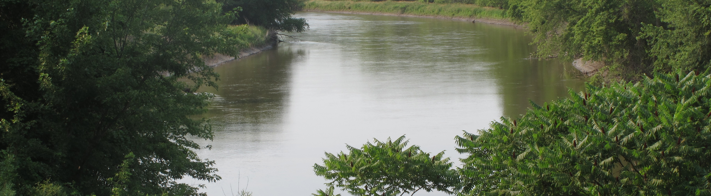

Minnesota River Hydrologic Snapshot
Steve Colvin | Director of Ecological and Water Resources
Optional Tagline Goes Here | mn.gov/websiteurl

Slide 2
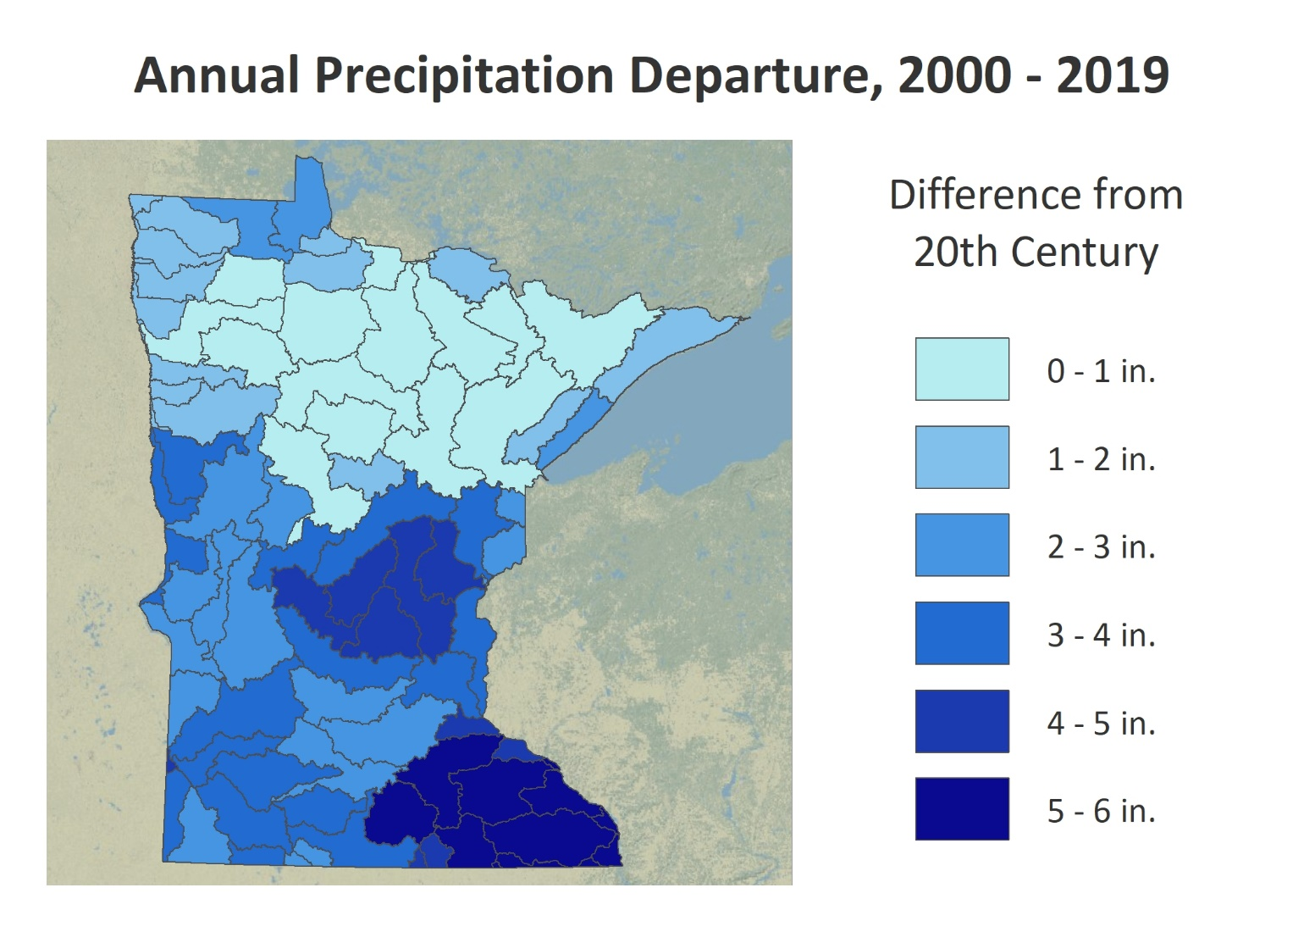

Recent Precipitation Increases

Slide 3
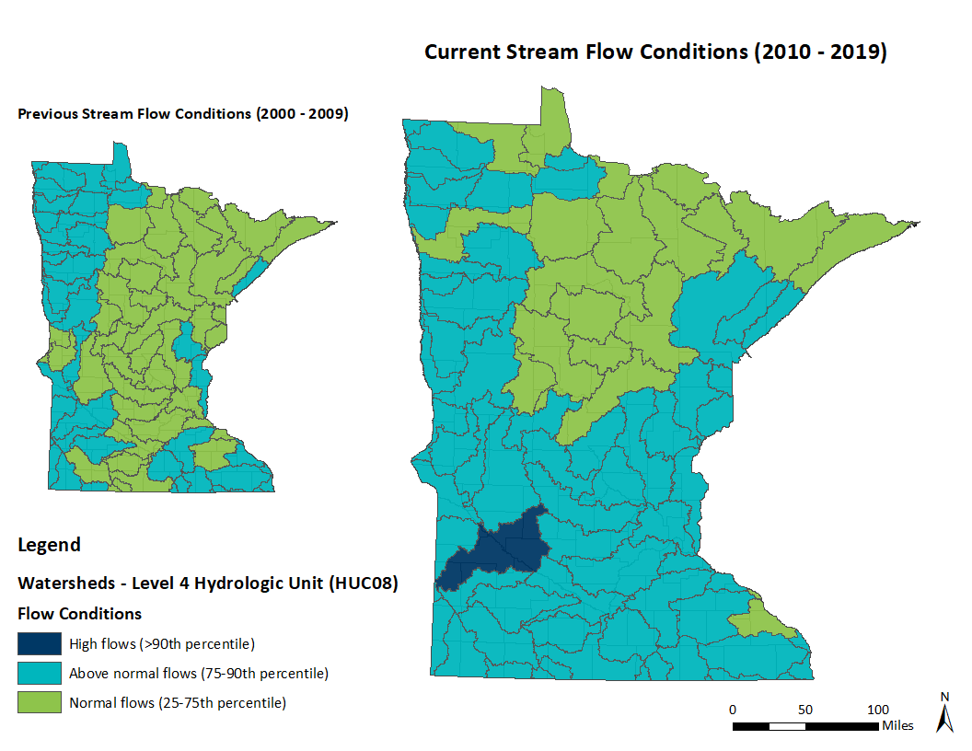
Current Stream Flow Conditions

Slide 4
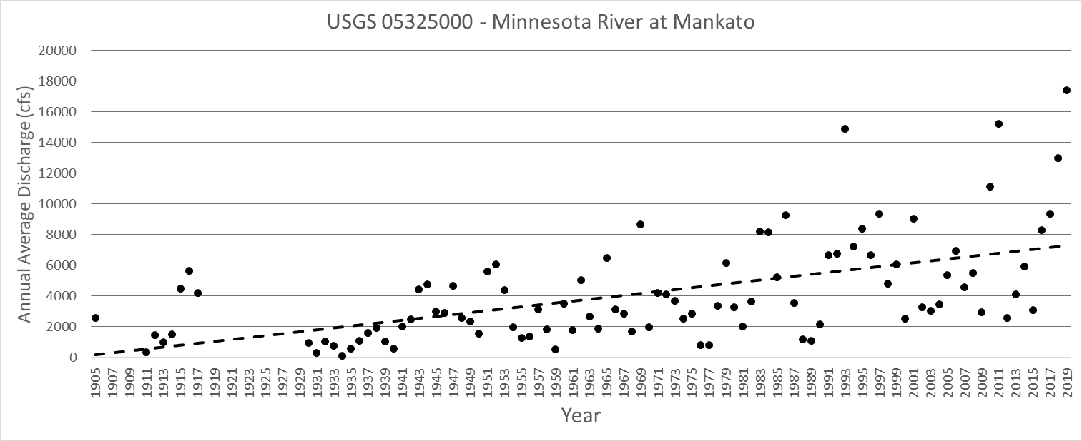
Annual Discharge (1905-2019)

Slide 5
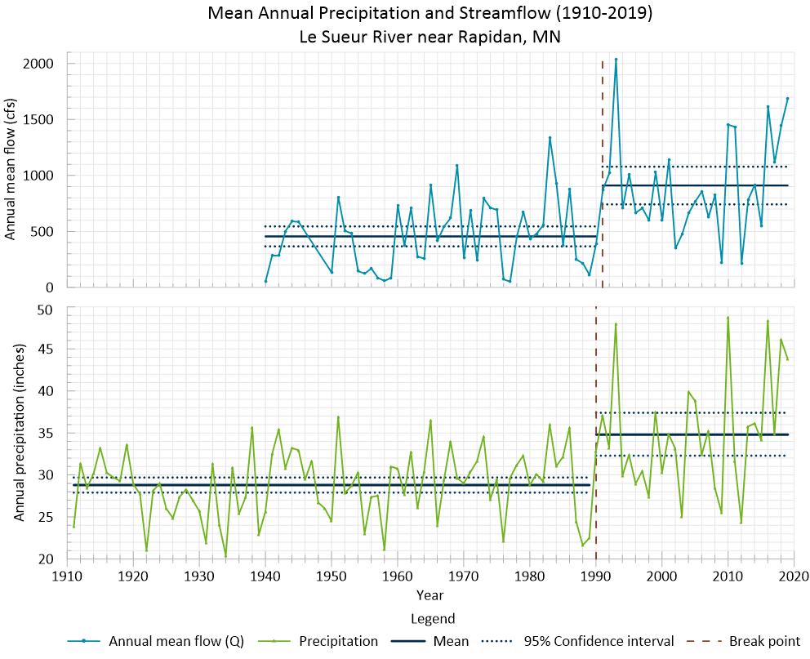
Annual Mean Flow and Precipitation

Slide 6
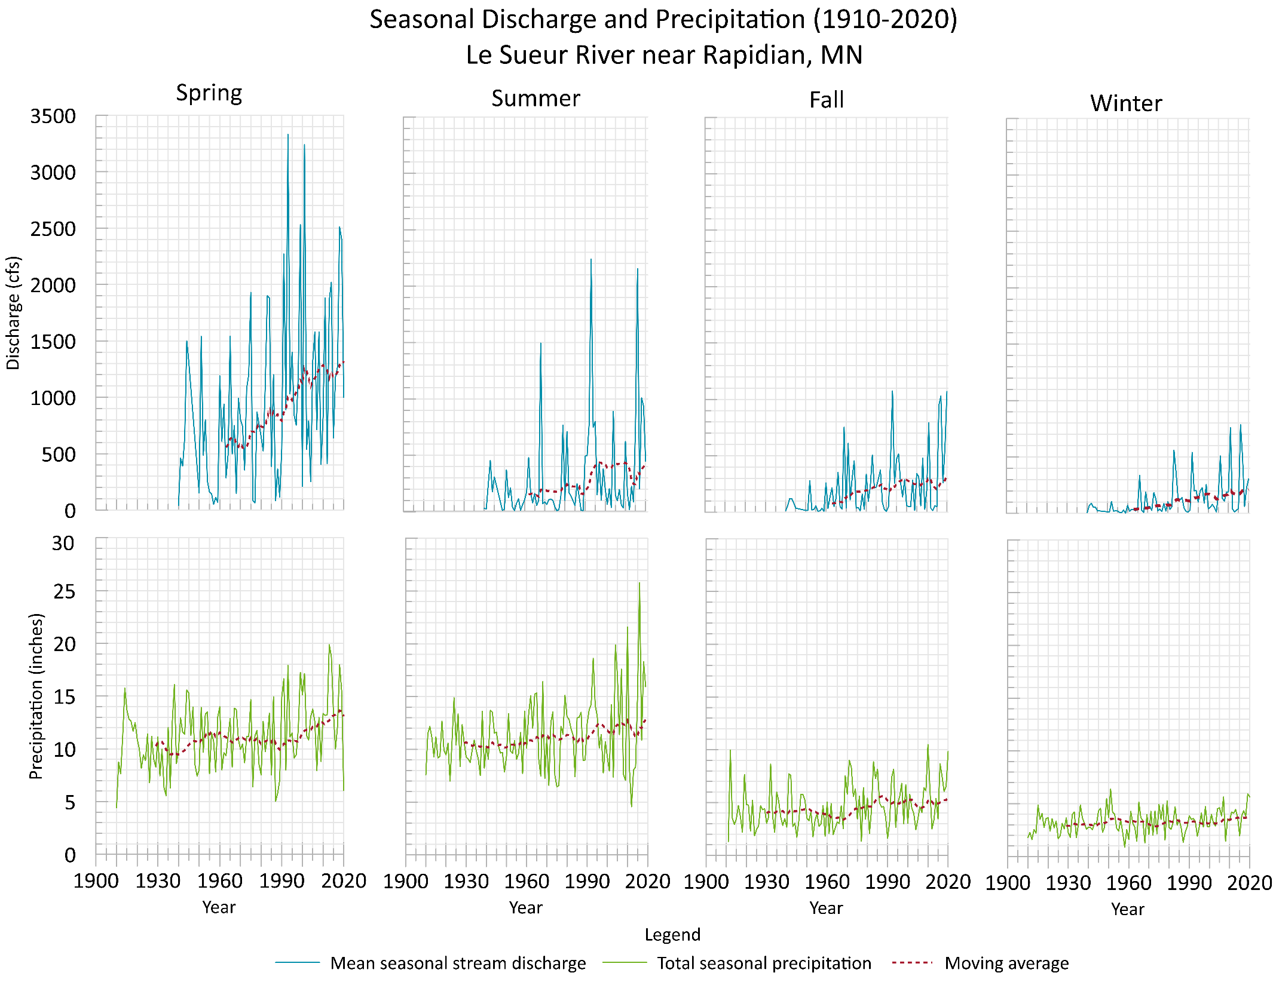
Seasonal Flow
Increasing trend for all seasons
Majority of increase is happing in March – April

Slide 7
Channel Forming Flows – Le Seuer
The number of days with discharge at or above “channel forming flows” essentially doubled in the last decade
These are the flows that move the most sediment over time and therefore shape the channel

Slide 8
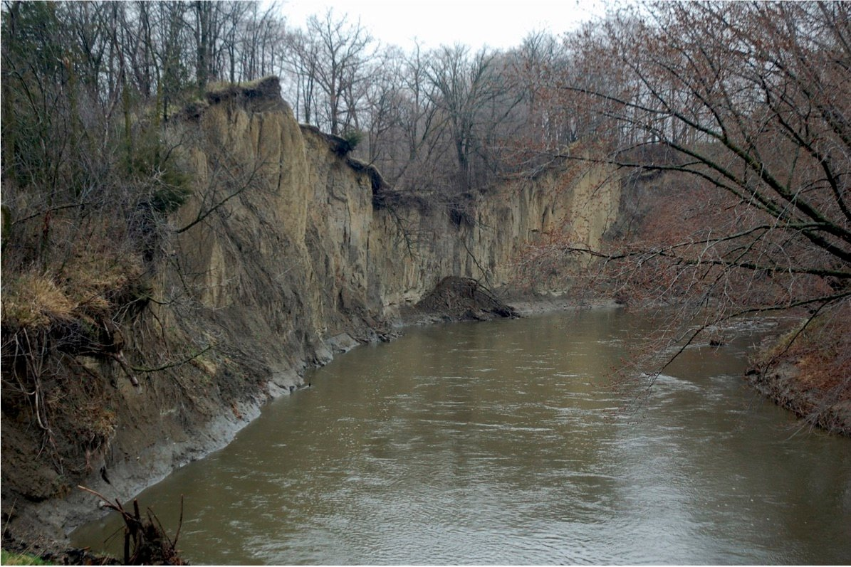
Highly Erosive Soils and Bluffs

Slide 9
Thank You!
Steve Colvin
Steve.Colvin@state.mn.us

